Slide 2
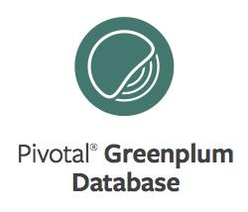
SQL Joins: Types and Implementation
Notes:
Intro: my name is, my role is, …

Slide 3
Agenda
What Join Types Are Available to You?
Row Elimination
Minimize Data Movement
Join Implementations Seen in Query Plans
Try the Lab

Slide 4
JOIN Types
Inner Join
Left Outer Join
Right Outer Join
x
Full Outer Join
Cross Join
Notes:
Joins in SQL enable us to combine data from different tables, and GPDB gives us this ability on very large data sets.
Here are the join types available to you as a SQL user:
Inner join – The inner join is possibly the most common type of join. The resulting data set is obtained by combining two tables on a common column. Each row of the left table is compared against each row of the right table. All matching rows are returned as part of the result set. An equijoin is an inner join that uses only equality comparisons in the join predicate.
There are three types of Outer Join: left, right, and full
Left outer join – Left outer join returns all of the rows from the left table even if there is no matching row in the right table. It also returns matching rows from the right table. Rows in the right table that do not match are not included as part of the result set.
Right outer join – (Similar to the left outer join) The Right outer join returns all of the rows from the right table even if there is no matching row in the left table. It also returns the matching rows from the left table.
Full outer join – Full outer join returns all rows from both tables where there is a match and returns NULL for rows that do not have a match.
Cross join – Cross join returns the Cartesian product of rows from tables in the join. The resulting data set consists of a combination of each row in the left table with each row in the right table. Two tables, each with five rows, will produce a resulting data set that contains twenty-five rows.

Slide 5
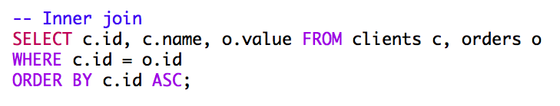
Inner Join
Can be simple to write
Require a join condition be specified
Are also known as a SIMPLE JOIN or EQUI-JOIN
Inner Join
Notes:
In this Inner Join example, we have an Equi-Join, since the join condition is the equals operator

Slide 6
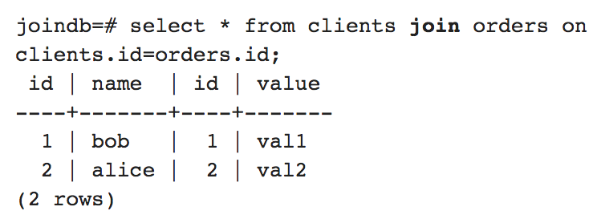
ANSI Syntax for Joins
Inner Join
Notes:
Alternative syntax for INNER join

Slide 7
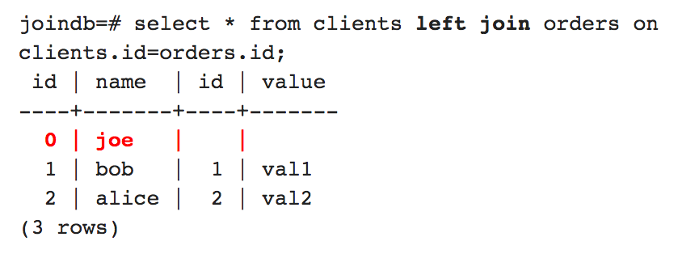
Left Outer Join
Left Outer Join
Notes:
A left outer join has that inner join result set plus the row for id = 0 from clients (shown in red)
Note that the implicit OUTER keyword is missing in this example.
Why might you need something like this? Suppose we have a list of clients and we
have purchase data from the last month. We might want a report of the sales for
all our clients, even those that didn't buy anything in that month. This sort
of report might be useful for the sales staff to target those clients.

Slide 8
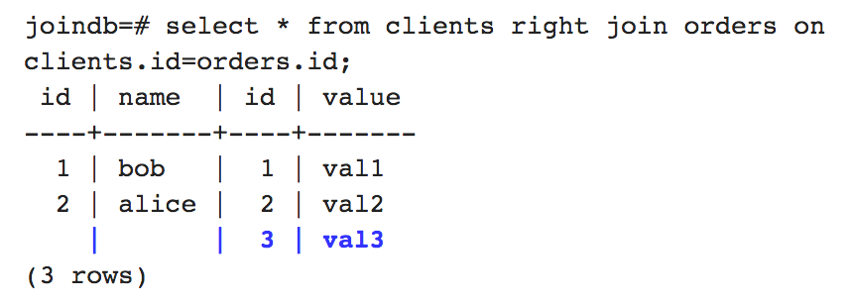
Right Outer Join
Right Outer Join
Notes:
A right outer join:
Returns all the joined rows, plus one row for each unmatched right-hand row.
Is functionally the same as the LEFT OUTER JOIN.
In either case, you need to take care to choose the left table and the right table.
Again, the OUTER keyword is implicit and not included here

Slide 9
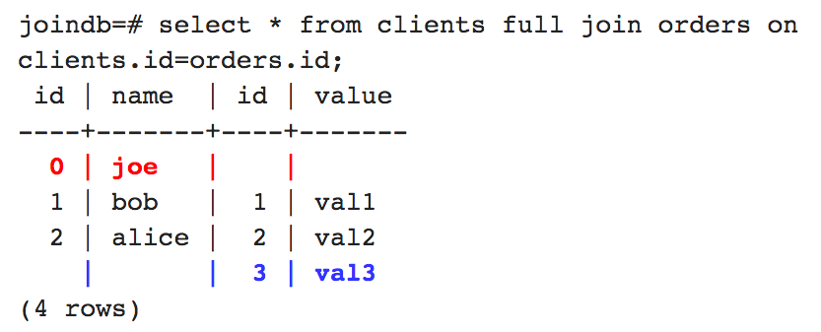
Full Outer Join
Full Outer Join
Notes:
The last type is a FULL OUTER JOIN, which combines a left and a right outer join.
Basically, an inner join, but with the addition of any missing rows from either table (the red and blue rows)

Slide 10
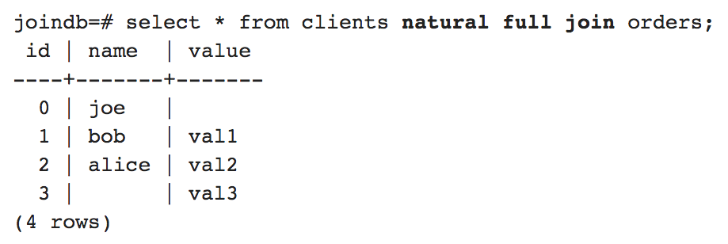
Natural Full Outer Join
Notes:
Recall from the previous slide that the `id’ column appeared twice in the output.
The NATURAL keyword provides a nice solution for that.
Ref. http://www.postgresql.org/docs/8.0/static/queries-table-expressions.html

Slide 11
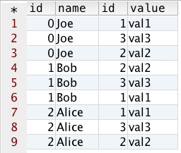
Cross Join (Cartesian Product)
x
Often, this is used unintentionally
Combines every row in the left table with every row in the right table
Specified with the CROSS JOIN syntax or by comma separating the table names, with no predicates
Cross Join
Notes:
A cross join may not be the type of join you should use when working on large data sets because it can result in huge transactions.
(Here: clients and orders tables)
For example, if you have a billion row table and CROSS JOIN it to a 100 row table, your resulting set will have 100 billion rows.

Slide 12
Row Elimination During Joins
Greenplum often has to use disk space to temporarily store data.
Query optimizer minimizes the amount of memory and disk space required by:
Projecting (copying) only those columns that the query requires
Doing single-table set selections first (qualifying rows)
Eliminating rows early
Notes:
When Greenplum executes a plan, it attempts to eliminate as many rows as possible.
The optimizer tries to be as restrictive as possible, before the joins, to reduce the number of rows returned for the join.
The goal is that the join is performed using only the rows and columns needed for the join.

Slide 13
Analyzing Row Elimination
Copies selected rows into temporary tables or spill files
Projects needed columns into spill file
Restricts data starting from the WHERE clause, then to the FROM statement, and finally to the SELECT statement
Temp space consumed is a function of the number of rows times the number of columns
SELECT U.USER_ID,
C.CNTRY_DESC
FROM USERS U
INNER JOIN COUNTRIES C
ON C.CNTRY_ID = U.CNTRY_ID
WHERE U.AREA_ID = 771
PROJECT LIST
EXPLICIT JOIN
JOIN CONDITION
SET SELECTION
Notes:
The example on the slide shows four columns the query is working on:
The first restriction is developed using the WHERE clause. It restricts the number of rows returned.
Next, the JOIN condition is applied.
Finally, the columns selected are specified in the SELECT statement, so the only columns projected are USER_ID, CNTRY_ID, CNTRY_DESC

Slide 14
Joins: Parallel Implementation
The core join algorithms will be the same as in non-distributed systems.
Additional details: how do we partition data and still guarantee correctness in a distributed system?
For the most part, these details are the same, regardless of the join algorithm (e.g. Merge, Hash, Nested Loop).
Notes:
Thanks to Caleb Welton for this (24 February 2016)

Slide 15
Row Redistribution / Motion During Joins
Generally speaking, if you can do a co-located join, you do.
Between broadcast and redistributed joins, the optimizer looks at the cost of motion that gets introduced and chooses the plan that it believes to be cheaper.
The optimizer depends on up-to-date statistics on the tables.
Notes:
Thanks to Caleb Welton for this (24 February 2016)

Slide 16
Co-located Join
If the join key is the distribution key for both tables:
We can guarantee¹ the join can be handled locally on each segment without redistribution.
This is the most efficient option.
This is a key consideration when designing your schema.
All equal keys are hashed to the same node, so join results will be correct.
[1] This assumes that the datatypes of the join keys is the same so that the hash algorithm for the join keys will hash the keys to the same segment.
Notes:
[1] This assumes that the datatypes of the join keys is the same so that the
hash algorithm for the join keys will hash the keys to the same segment. There
is special consideration of int2/int4/int8 so that they will hash in a stable
fashion across datatypes, but if you were joining an integer to a float, or an
integer to a string then this guarantee goes away and you will need to employ a
strategy other than the co-located join.
Thanks to Caleb Welton for this (24 February 2016)

Slide 17
Broadcast Join
Neither table is distributed by the join keys.
One table is considerably smaller than the other table.
We may broadcast the smaller table.
All segments see a complete copy of the smaller table.
They perform a co-located join.
Each row of the larger table can see all target rows in the smaller table, so join results will be correct.
Notes:
Thanks to Caleb Welton for this (24 February 2016)

Slide 18
Redistributed Join
One, or both, of the tables are not distributed on the join keys.
We can redistribute the table(s).
They perform a co-located join.
All equal keys are hashed to the same node, so join results will be correct.
Notes:
Thanks to Caleb Welton for this (24 February 2016)

Slide 19
Join Implementations
The means that GPDB uses to join two tables
These are what you will see in query plans:
Sort Merge
Hash
Nested Loop
Notes:
These are the join methods seen in a query plan:
Sort Merge Join
Hash Join
Nested Loop Join

Slide 20
Sort Merge Join
Common when the join condition is based an inequality operator, like <, <=, >, >= (but not <>)
Steps:
Sort the tables by the join attribute.
Scan the two tables in parallel.
Combine matching rows to form join rows.
Notes:
Each relation is sorted on the join attributes before the join starts. Then the
two relations are scanned in parallel, and matching rows are combined to form
join rows. This kind of join is more attractive because each relation has to be
scanned only once. The required sorting might be achieved either by an explicit
sort step, or by scanning the relation in the proper order using an index on
the join key.
Ref.:
http://stackoverflow.com/questions/1111707/what-is-the-difference-between-a-hash-join-and-a-merge-join-oracle-rdbms
https://en.wikipedia.org/wiki/Sort-merge_join
http://www.postgresql.org/docs/8.4/static/planner-optimizer.html

Slide 21
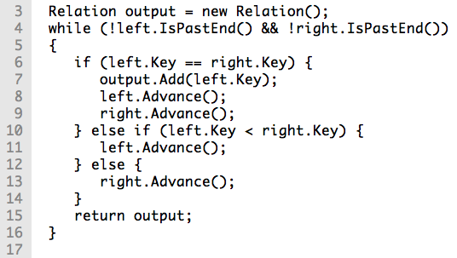
Illustration of the Sort Merge Join Process
Notes:
Ref. https://en.wikipedia.org/wiki/Sort-merge_join

Slide 22
Hash Join
Build phase:
Scan smaller table, creating in-memory hash table.
Keys are join columns
Values are the corresponding rows
Probe phase:
Scan the larger table and find the relevant rows from the smaller relation by looking in the hash table.
Notes:
(the in-memory hash table is of the smaller table)
The lookups in the hash table are very fast since it’s in memory
Ref. https://en.wikipedia.org/wiki/Hash_join

Slide 23
Nested Loop Join
Can be one of the most efficient types of joins.
For each row of the “left table” (loop):
Scan the right table to find a match (nested loop)
Indexes on the join columns make this more efficient
This type of join is typically inefficient, though
Notes:
Ref. http://www.postgresql.org/docs/8.3/static/planner-optimizer.html

Slide 24
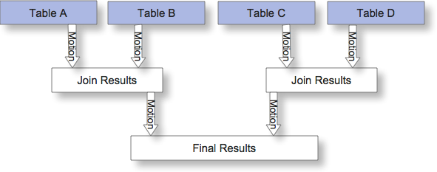
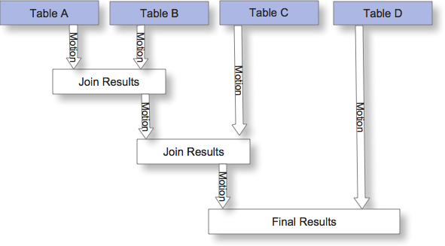
N-Tables
All n-table joins are reduced to a series of two-table joins
The query engine can only work on two tables at a time
The final result must be built up by a tree of join steps, each with two inputs.
Notes:
When the query involves more than two relations, the final result must be built up by a tree of join steps, each with two inputs.
The planner examines different possible join sequences to find the cheapest one.

Slide 25
Wrap Up
What Join Types Are Available to You?
Row Elimination
Minimize Data Movement
Join Implementations Seen in Query Plans
Do the Lab
Thank You!
Notes:
Big data, complex analytical queries, and BI Tools pose immense challenges for query planner/optimizers; PQO was built from the ground up to tackle this challenge.
PQO can be enabled or disabled at the cluster, or instance, level (gpconfig); the DB level; or the session/query level.
PQO requires statistics on the root partition of partitioned tables, and the `analyzedb’ command is great for this.
At this point, I suggest reviewing by jumping right into the lab.
Thank you!

